Slide 1

Deep Learning and Translation Technology
Sai Cheong SIU
The Hang Seng University of Hong Kong
30 May 2023

Slide 2
About this Chapter
Chapter 47 (pp.797-817), Routledge Encyclopedia of Translation Technology (2nd Edition)
Deep Learning and its application to translation technology (e.g., machine translation, speech translation, and more).

Slide 3

Background: Deep learning is everywhere!
Examples:
Stable Diffusion (Rombach et al. 2022)
ChatGPT (OpenAI, 2022)

Slide 4
Chapter Outline: 5 Parts
Introduction
Main Tasks of Deep Learning
Deep Learning and Machine Translation
More Areas: Speech Translation, Multimodal Translation, and Translation Memory
Other Noteworthy Trends

Slide 5











Part 1: Introduction
1. Versatility across domains
2. Multilayered Artificial Neurons
Artificial Intelligence
Machine Learning
3. Feature Extraction and Representation
4. Resurgence in Popularity
Deep Learning

Slide 6






Part 2: Key Concepts
1. Key Components
2. Key Tasks
1. Data Collection
2. Model Design
Training
Validation
Test
Neuron?
Connection?
Data
Network
3. Model Training
4. Model Evaluation
Forward propagation
Loss calculation
Backpropagation
Optimization
Algorithm

Slide 7
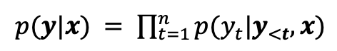
Part 3: Deep Learning and Machine Translation
Neural Machine Translation
Rule-based Machine Translation
Example-based Machine Translation
1. Recurrent Neural Networks
2. Convolutional Neural Networks
3. Self-attention Neural Networks
Statistical Machine Translation
ST
encoder
z
decoder
TT
Common:
Different

Slide 8
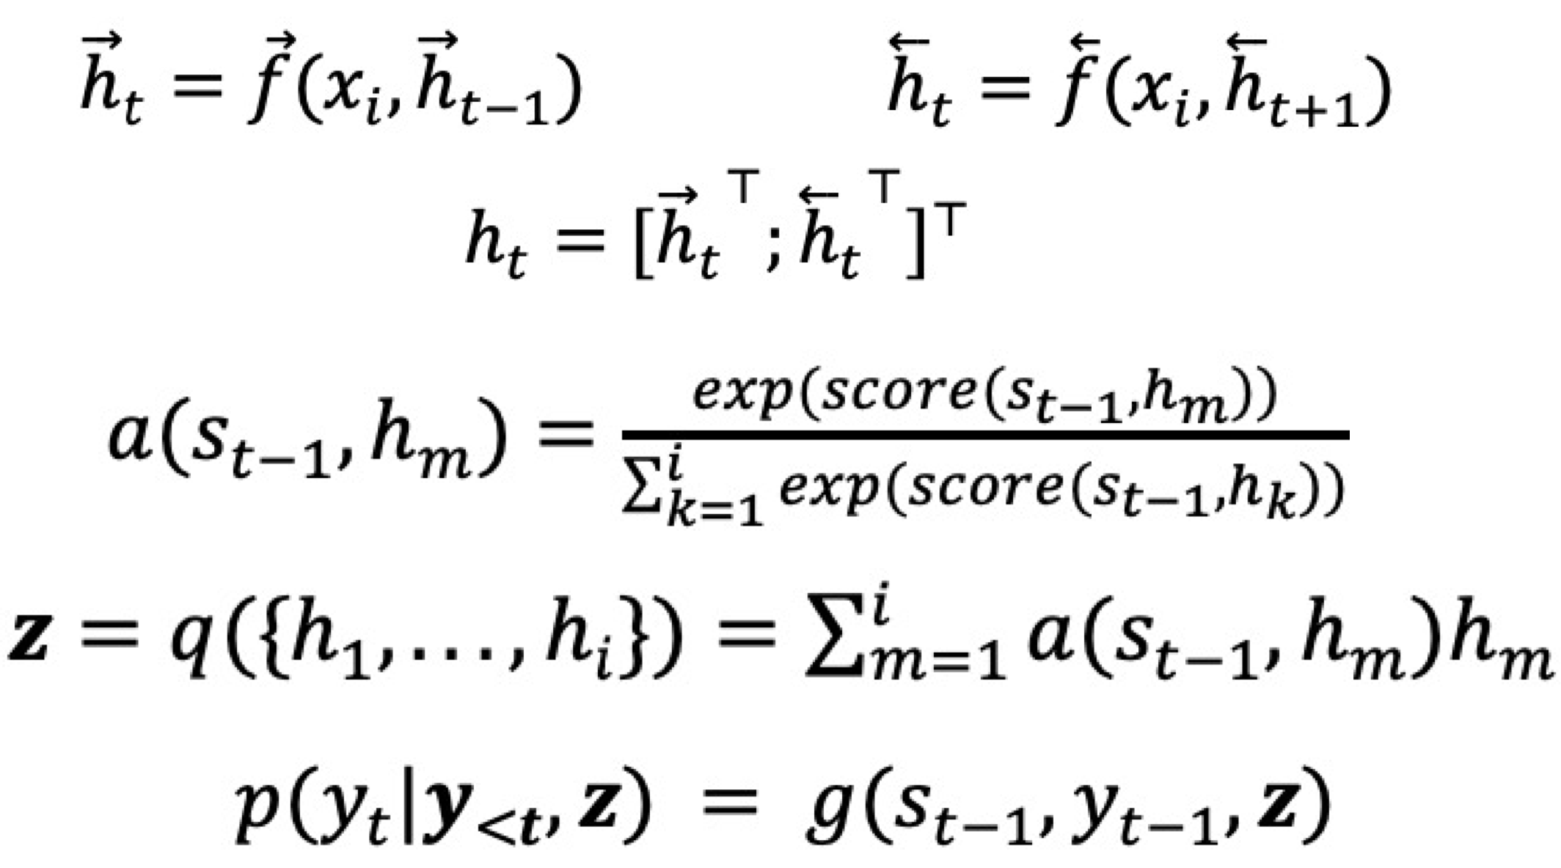
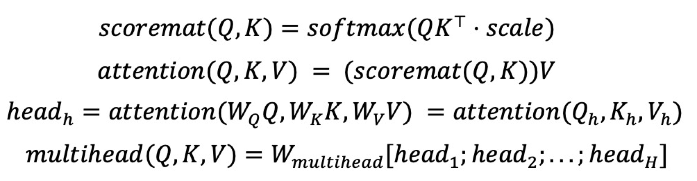
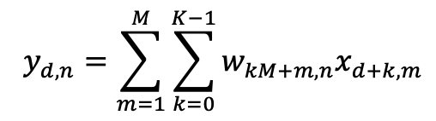
Part 3: Deep Learning and Machine Translation
1. Recurrent Neural Networks (RNN)
2. Convolutional Neural Networks (CNN)
3. Self-attention Neural Networks (e.g., Transformer)
Bidirectional RNN with Attention
One-dimensional convolutional layer
Multi-head Attention with Queries, Keys and Values
Example:
Example:
Example:

Slide 9








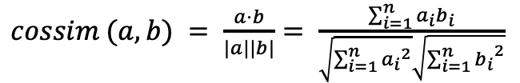
Part 4: Deep Learning for Other Translation-related Applications
A. Deep Learning and Speech Translation
B. Deep Learning and Multimodal Translation
C. Deep Learning and Translation Memory
Cascade systems
Conventional Approach
Common
expressions?
Image-to-text translation
Video-to-text translation
Similarity
ASR
MT
TTS
Deep Learning Approach
End-to-end systems
Embeddings
S2S
Text-to-image translation
Text-to-music translation

Slide 10
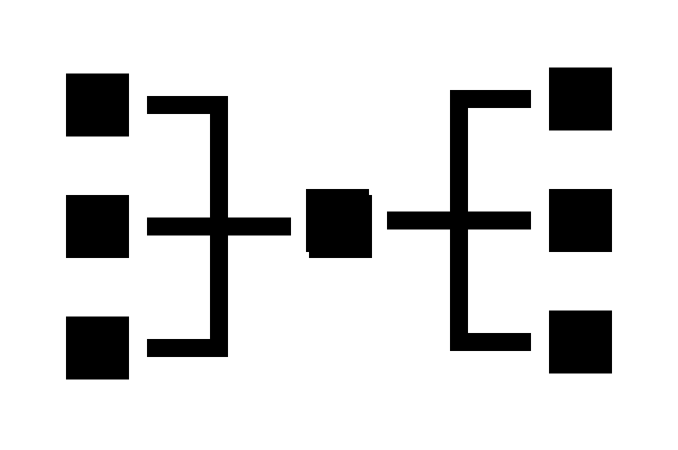












Part 5: Other Noteworthy Trends
Multilingual NMT
Multiple Models
Deeper Models
Multiple language pairs
More Layers
Document-level NMT
Domain Adaptation
Pre-trained language models (e.g., ChatGPT)
As sentences
Connection
1
2
3
1. Pre-training
3. Multiple Tasks!
2. Fine-tuning / Prompt engineering
As a document
Specialized translation models

Slide 11


The Way Forward
Deep learning is a rapidly evolving field that offers exciting possibilities for machine translation and other applications in translation technology.
This chapter provides a concise overview of key concepts and research findings in deep learning, along with references to over 100 publications.
Whether you are a researcher, practitioner, or simply curious about the possibilities of deep learning, this chapter offers a valuable starting point for further study and exploration.

Slide 12
Thank you!
OpenAI. 2022. Introducing ChatGPT. https://openai.com/blog/chatgpt.
Rombach, R., A. Blattmann, D. Lorenz, P. Esser, and B. Ommer. 2022. High-resolution image synthesis with latent diffusion models. In Proceedings of the IEEE/CVF Conference on Computer Vision and Pattern Recognition, 10684-10695. The IEEE Computer Society and The Computer Vision Foundation.
Siu, S.C. 2023. Deep Learning and Translation Technology. In Routledge Encyclopedia of Translation Technology (2nd edition), ed. S.W. Chan, 797-817. Routledge: London.

